Slide 1

Exploring the Potential Contributing Factors to Diabetes
Presented by:
Saudia Epps
Kolton Ascheman
Nathan Trnka
Marsha Cole
February 14, 2024

Slide 2
Introduction
Diabetes, also known as Diabetes mellitus, represents a significant global health challenge, with its prevalence steadily increasing.
In the United States, the Centers for Disease Control and Prevention's 2022 data indicate that over 133 million individuals are affected by either Diabetes (37.3 million) or prediabetes (96 million).
This escalating burden highlights the importance of understanding the contributing factors.

Slide 3
Questions
The aim of our exploratory data analysis was to address the following :
What are some of the trends between contributing factors?
How many diabetics do not have any of the other illnesses/behaviors?
Is there a combination of factors that tend to correlate with a diabetic diagnosis?

Slide 4
Data Source and Collection
Data was sourced from the diabetes prediction dataset via Kaggle.
Is a collection of medical and demographic data from patients and their diabetes status (positive or negative).
The dataset consisted of 100,000 rows and nine variables, including gender, age, hypertension, heart disease, smoking history, body mass index (BMI), HbA1c level, blood glucose level, and diabetes status.

Slide 5
Data Cleaning and Preparation
The dataset was imported from the provided CSV file and stored in a new variable for analysis and data cleaning and preparation were done:
Replacing the values (0, 1) with more interpretable True/False values.
Limiting the scope of the study to adults aged 21 and above.
Removing patients whose smoking history was labeled as "ever“.
Eliminating rows with null values in essential variables.
Post cleaning the dataset had 73,978 rows. Further filtering was then applied to isolate individuals who reported having Diabetes, resulting in a subset of 7,913 individuals.

Slide 6
Data Analysis Methods
Summary statistics were calculated for continuous variables.
For categorical variables percentages were used to show the distribution of each category within the sample.
Visualization techniques such as bar charts, scatter plots and box plots were employed to visualize the distribution of diabetes status across different variables.

Slide 7
Findings
Among individuals in the dataset, approximately one-tenth (10.7%) reported having Diabetes. Of those with Diabetes:
a slightly higher proportion (53%) identified as female
47% identified as male.
A significant amount (42%) reported never smoking, whereas:
20% were former smokers
12% were current smokers
27% had no reported smoking history (18%) or current status (9%)

Slide 8
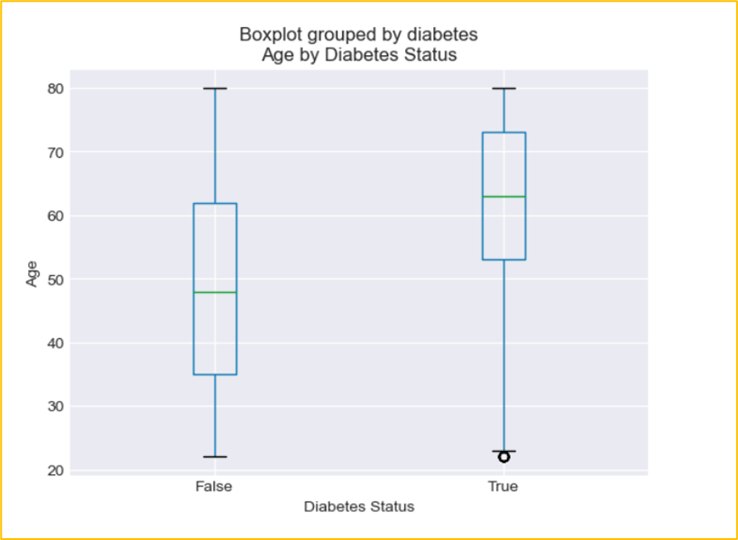
Age by Diabetes Status
Average age for Diabetes was 61.7 years (SD = 13.55), and 49.43 years (SD = 16.87).for non-diabetics.
The majority (88%) of those who reported having Diabetes were aged 45 years and older.
Quartiles and outliers for Age - Diabetes:
Lower quartile: 53.0
Upper quartile: 73.0
Interquartile Range: 20.0
Values below 23.0 could be outliers.
Values above 103.0 could be outliers.
Figure 2: Box plot showing age by Diabetes status

Slide 9
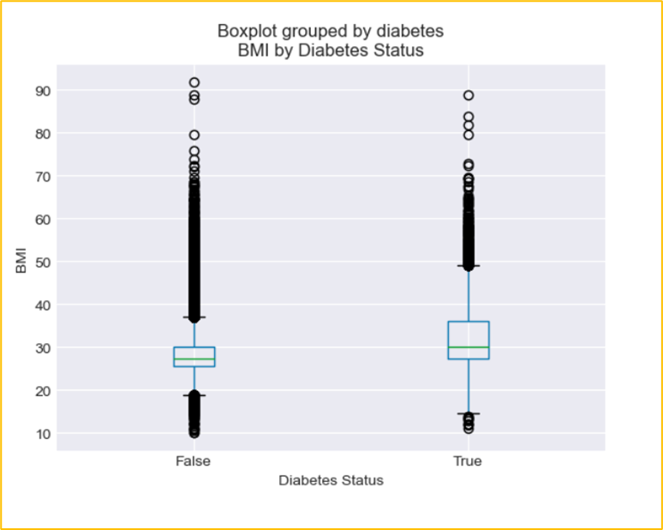
BMI by Diabetes Status
Average BMI for Diabetes was 32.12 kg/m² and 28.39 for non-diabetics.
A significant proportion of those with Diabetes were overweight (40%) and obese (50%).
Quartiles and outliers for BMI - Diabetes:
Lower quartile: 27.32
upper quartile: 36.01
Interquartile Range: 8.69
Values below 14.29 could be outliers.
Values above 49.04 could be outliers.
Figure 2: Boxplot showing BMI by Diabetes status

Slide 10
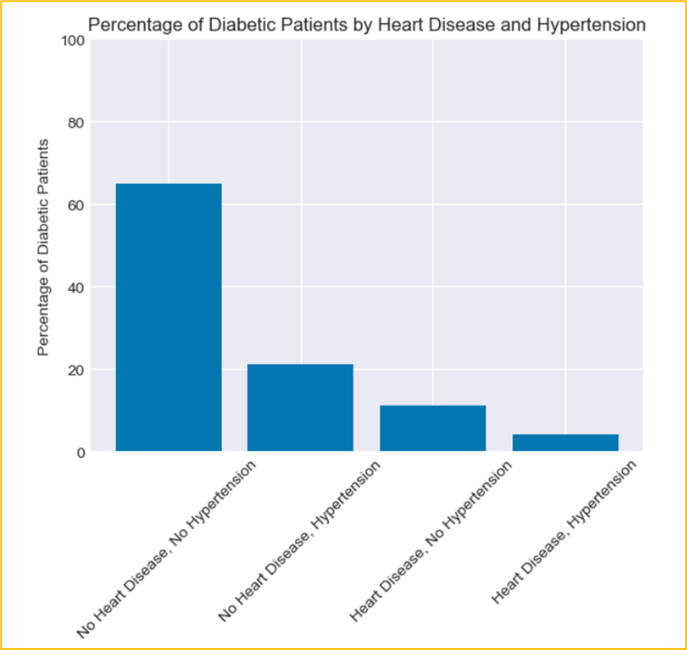
Heart Disease and Hypertension
The majority (65%) of Diabetes do not have heart disease or hypertension.
21% have hypertension but no heart disease.
11% have heart disease but no hypertension.
4% have both hypertension and heart disease.
Figure 5: Bar chart showing percentage of Diabetics by Heart Disease and Hypertension

Slide 11
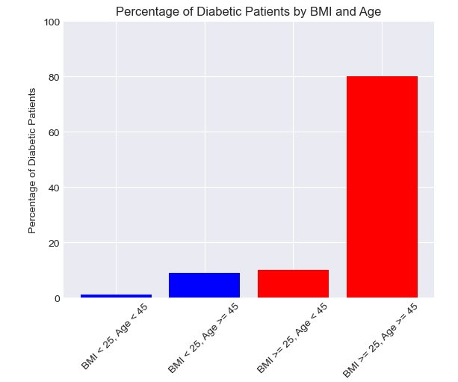
Diabetes by BMI and Age
The majority (80%) were aged 45 or older and have a BMI of 25 or higher.
10% were under the age of 45 and had a BMI of 25 or higher.
9% were are aged 45 or older but had a BMI under 25.
1% were under the age of 45 and had a BMI under 25.
Figure 6: Bar chart showing percentage of Diabetics by BMI and age

Slide 12
Implications
An understanding of the demographic patterns associated with diabetes diagnosis allows for targeted interventions that are tailored to specific populations.
Given the association between obesity (indicated by BMI) and diabetes, interventions focusing on weight management and lifestyle modifications are vital.
Overall, the implications of these findings highlight the need for comprehensive, multifaceted approaches to diabetes prevention, management, and intervention strategies that consider the diverse factors influencing diabetes risk and outcomes.

Slide 13
Limitations
The classification of Diabetes types (Type 1, Type 2, or Gestational Diabetes) was not provided in the dataset.
The dataset did not specify the blood glucose level measurement type (e.g., fasting or random blood glucose tests). This omission limits our ability to differentiate between fasting and non-fasting blood glucose levels.
Thirdly, some individuals were excluded from the analysis due to discrepancies in their smoking history labeling; this exclusion may introduce a potential bias. Uncertainty surrounding the accuracy of the labeling (whether "ever" was a mistyping of "never") highlights a limitation in the quality and reliability of the data.

Slide 14

Next Steps
Should involve the developing and implementing comprehensive health promotion strategies, including targeted education campaigns, smoking cessation programs, and obesity management initiatives.
It is imperative to investigate additional contributing factors such as alcohol consumption, genetics, family history, prediabetes, race, and ethnicity.

Slide 15
References
International Diabetes Federation (2024). https://idf.org/about-diabetes/diabetes-facts-figures/
Mohammed Mustafa (2023). Diabetes prediction dataset: A comprehensive dataset for predicting Diabetes with medical and demographic data. https://www.kaggle.com/datasets/iammustafatz/diabetes-prediction-dataset/data
Wu Y, Ding Y, Tanaka Y, & Zhang W. (2014). Risk factors contributing to type 2 diabetes and recent advances in the treatment and prevention. International J Medical Sciences 6;11(11):1185-200. doi: 10.7150/ijms.10001. PMID: 25249787; PMCID: PMC4166864.

